Slide 1

BIT CRAFTERs

Slide 2
OUR TEAM MEMBERS
Navjot Singh (team leader)
Harleen Kaur
Mehakpreet Singh
Priya
Amanpreet Kaur
Gagandeep Kaur

Slide 3

OUR PROBLEM STATEMENT:-
Prepare a solution to allow an activity incharge to register, mark attendance, see student involvement level (participant/organizer/winner) in an event and generate an non temperable e- certificate.

Slide 4

AGENDA
The agenda of this problem is to develop a solution that allows activity incharges to manage events and generate e-certificates in a more efficient, accurate, and secure manner.
In short, the goal of this project is to develop a system that makes it easier for activity incharges to run events and for students to participate in them. This system should be efficient, accurate, secure, and user-friendly.

Slide 5

Website Development
Event Management
Registration and Attendance
Student Involvement Tracking
Certificate Generation

Slide 6
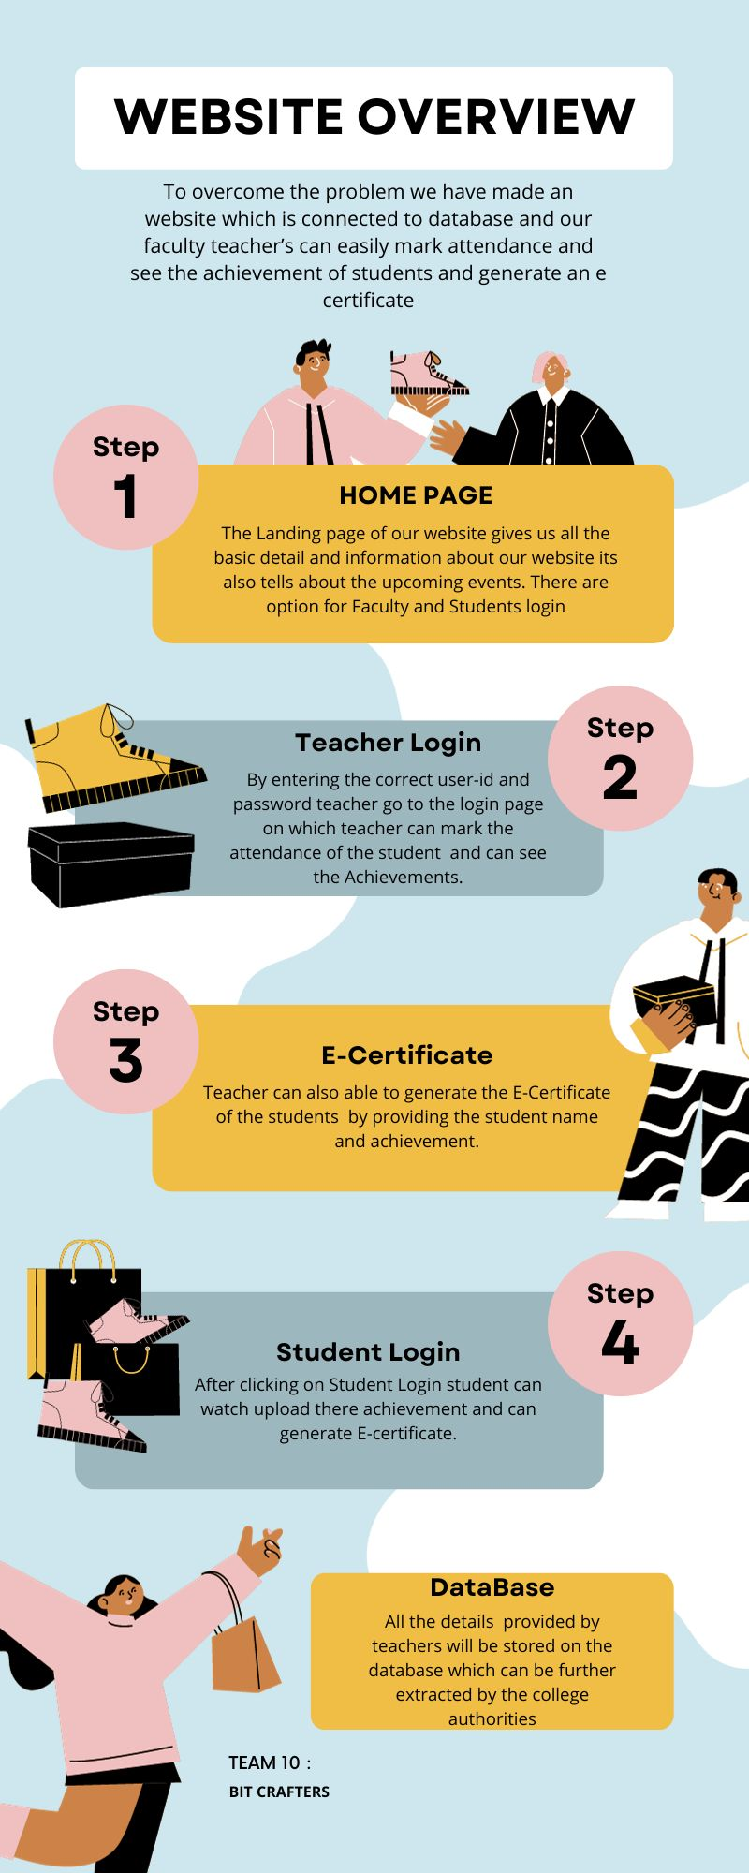
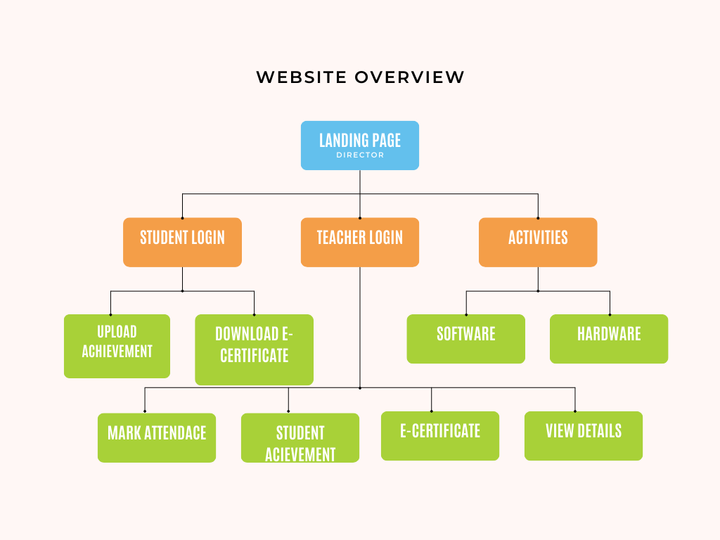

Slide 7

Working of our website
Landing Page

Slide 8
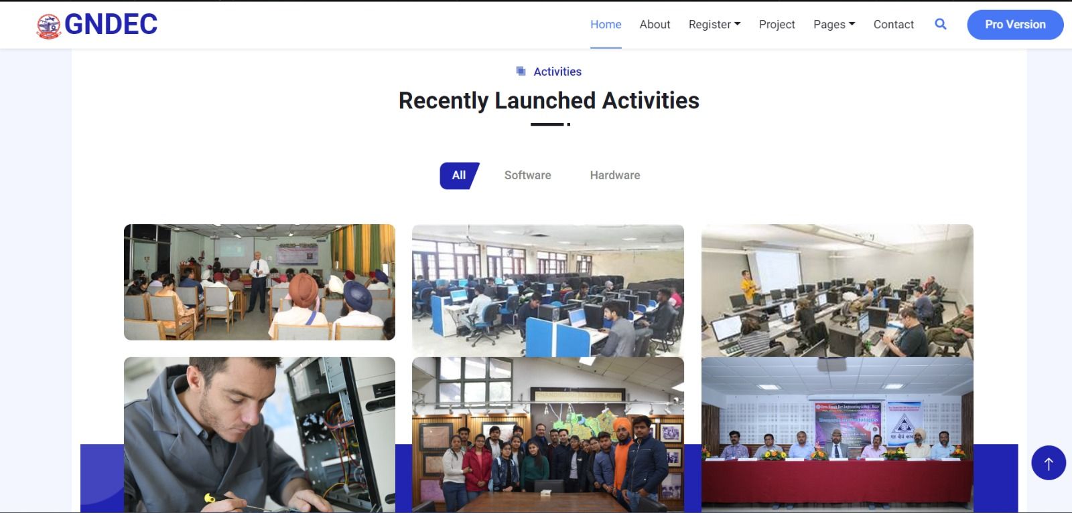
Activity Management

Slide 9

Registration
Register for teacher/ student

Slide 10

Teacher Login

Slide 11
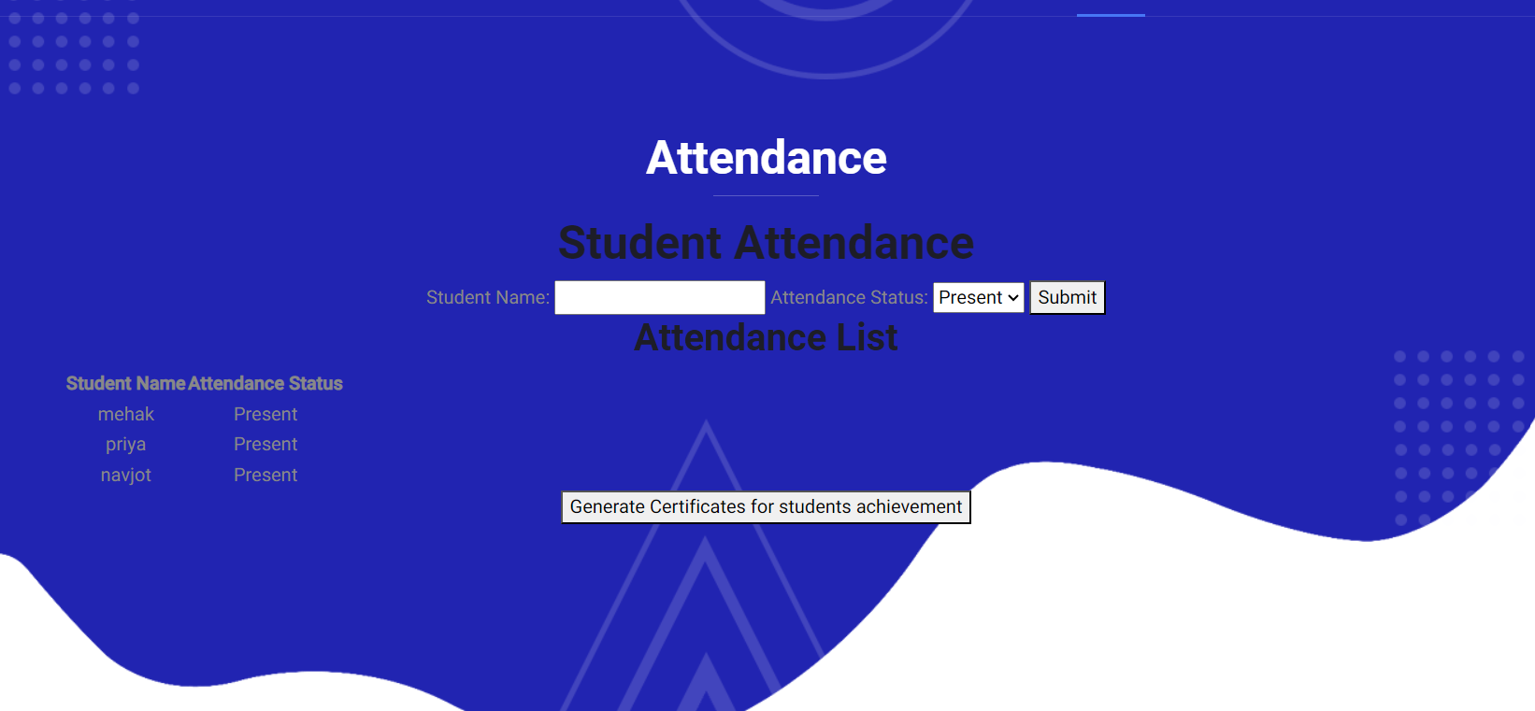
Attendance Management

Slide 12

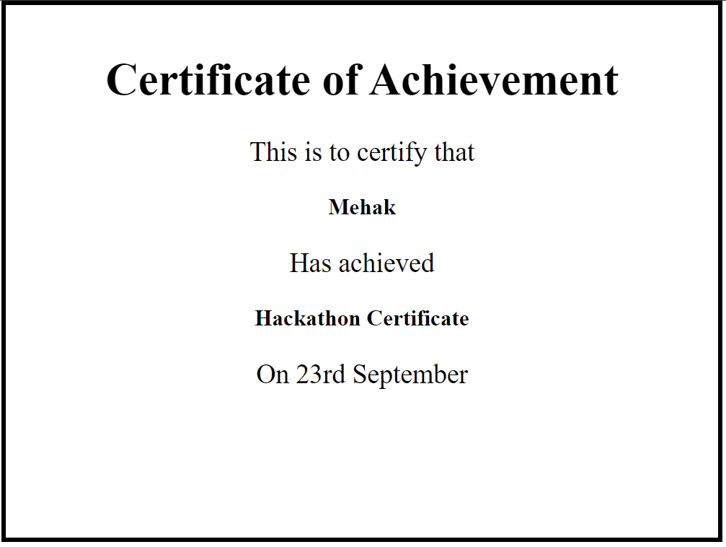
Certificate Generation

Slide 13


